Slide 1
Mobile Testing

Slide 2
Agenda
Introduction to Mobile testing
Key factors in mobile testing
APPIUM
Appium Architecture
Advantages
Example /Practical session
Disadvantages

Slide 3
Mobile Testing
Mobile Application is different from the desktop apps
Testing process depends on the type of application
Mobile apps are mainly divided into 3 types
Mobile web application
Native app
Hybrid app

Slide 4
Key factors in mobile testing
For effective mobile testing consider the key elements
Types of testing
Target device selection
Testing Approaches
Network

Slide 5
Key factors in mobile testing Cont.…
Types of testing
Functional testing
Performance testing
Security testing
Recovery testing
Memory leakage testing
Interrupt testing
Usability testing
Installation testing
Localization testing
Compatibility testing

Slide 6
Testing Types
Testing Types | Test conditions | Example
Functionality testing | Behaviour of the app | Login ,Logout,
Performance testing | Network connectivity, Battery usage, concurrent users to app | App behaviour in switching between 3G,4G,broadconnectivity
Memory leakage testing | Memory used in optimized way | Release of unused memory
Interrupt testing | App able to hold interruptions | Incoming calls, Notifications
Localization testing | App adaptable to specific location audience | Language translation, Date formats
Security testing | Security of the app | Unauthorized access, User data protection from attacks
Compatibility testing | App compatibility | Cross platforms, device configurations

Slide 7
Key factors in mobile testing Cont.…
Target device selection
Depends on OS versions
App behaviour that supports both tablets and smartphones
Real devices /Emulators /Simulators
Network
Network WIFI connectivity or cellular network with different data rates
Test Automation
Manual testing or Automation testing or Cloud testing

Slide 8
APPIUM
It is an open-source tool for automating native, mobile web and hybrid application.
Support both Android and IOS devices.
It is cross –platform. No need to different code for Android and IOS
Supports multi languages

Slide 9
Application Type
Native App - App that don’t run in browser – I.e. Gaming Apps
Web Application/View - Application that don’t have App - myblog
Hybrid App – Combination of Native and web view - Amazon, AA

Slide 10
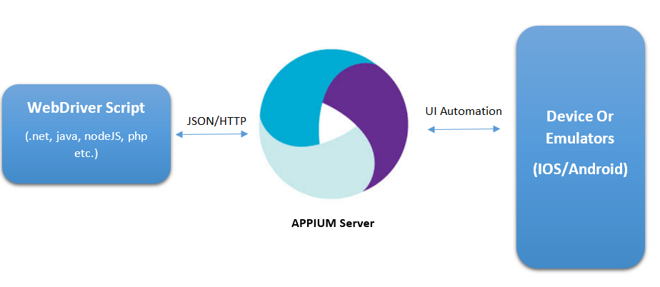
How Appium works
Appium is based on client-server architecture
Appium client (C# or Java) connects with Appium Server and communicate via JSON Wire Protocol
Appium Server then creates a automation session for the client and also checks the desired capabilities of client and connects with respective vendor(based on android versions)

Slide 11
Comparing Appium with others
Tools | Languages | OS | Application Type
Appium | C#,Java,Phyton, Ruby etc | Android/IOS | Native/Web/Hybrid
Xamarin | C# | Android/IOS | Native/Web/Hybrid
Robotium | Java | Android/IOS | Native/Web/Hybrid
Selendroid | Java | Android/IOS | Native/Web/Hybrid

Slide 12
Advantages of APPIUM
Open source , supports various types of apps
Supports various programming languages
Able to test in IOS and ANDROID
Allow testers to use Real devices , Simulators and Emulators

Slide 13
Practical session
Questions and Doubts

Slide 14
Packages
Install the below packages to start mobile app testing
Selenium webdriver
Appium webdriver

Slide 15
Desired Capabilities
Keys and values encoded in JSON object
Sent to the server by the Appium clients when automation session is started
It is specific to client language
It tells how to carry out test in which device, platform and server

Slide 16
Desired Capabilities Cont.…
Required desired capabilities to start the test are
Platform name e.g. Android
Platform version e.g. 4.4.2
Device name e.g. ASUS_TOOJ
App Package - name of the test app
App Activity - activity to start the app

Slide 17
Ways to find appPackage &appActivity
Install APK.info app in your real devices
Using Command Prompt
Type the following commands
adb shell
Now open the app under test
Type dumpsys window windows | grep –E ‘mCurrentFocus’ or
dumpsys window windows | grep –E ‘mFocusedApp’

Slide 18
Disadvantages
Does not support all android versions. It supports from 4.2 or later
Lacks capability to recognize image
Does not provide support for android alert handling

Slide 19
References & Links
http://appium.io/docs/en/writing-running-appium/caps/
http://www.automationtestinghub.com/identify-mobile-browser-elements-appium-part-1/
http://www.automationtestinghub.com/appium-tutorial/
https://geteasyqa.com/qa/mobile-apps-testing/
http://www.automationtestinghub.com/apppackage-and-appactivity-name/
https://www.softwaretestingclass.com/mobile-testing-tutorial-1-mobile-application-testing-strategy/

Slide 20
THANK YOU

